Slide 1





Vanishing adsorption admissibility criterion for contact discontinuities in the polymer model
Yulia Petrova PUC-Rio
yulia-petrova.github.io
30 January 2024
The talk is based on:
Y. Petrova, B. Plohr, and Marchesin D. Vanishing adsorption admissibility criterion for contact discontinuities in the polymer model. arXiv:2211.10326.
F. Bakharev, A. Enin, Y. Petrova, and N. Rastegaev. Impact of dissipation ratio on vanishing viscosity solutions of the Riemann problem for chemical flooding model. Journal of Hyperbolic Differential Equations, 20:1–26, 2023.

Slide 2
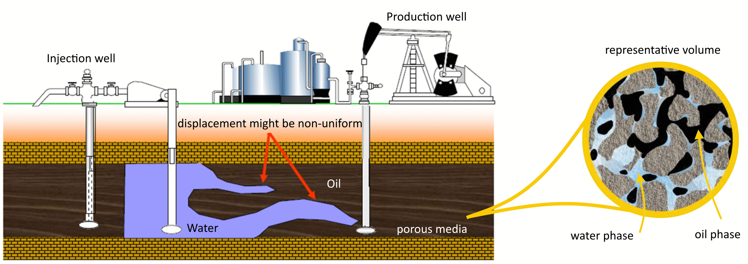
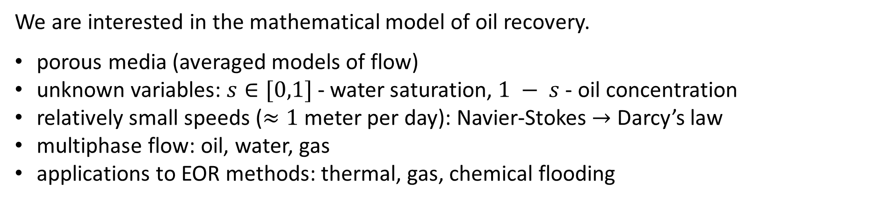
Motivation: enhanced oil recovery (EOR)
We are interested in the mathematical model of oil recovery.
porous media (averaged models of flow)
unknown variables: $s∈[0,1]$ - water saturation, $1 − s$ - oil concentration
relatively small speeds ($≈1$ meter per day): Navier-Stokes $→$ Darcy’s law
multiphase flow: oil, water, gas
applications to EOR methods: thermal, gas, chemical flooding
1

Slide 3

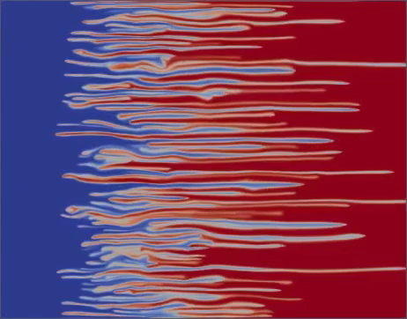
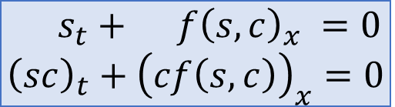
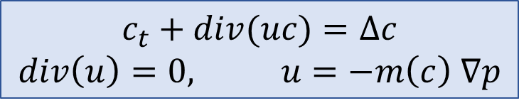
Two main directions of investigation
Stable displacement (1-dim)
Unstable displacement (2-dim)
hyperbolic conservation laws
main question: find an exact solution for a Riemann problem
viscous fingering phenomenon
source of instability: water and oil/polymer have different viscosities
$$s_{t}+ f{\left(s,c\right)}_{x} =0 \\ {\left(sc\right)}_{t}+{\left(cf\left(s,c\right)\right)}_{x}=0$$
$$c_{t}+div(uc)=Δc$$
$$div\left(u\right)=0, u=−m\left(c\right) ∇p$$
Example: polymer model
Example: incompressible porous media equation (IPM)
2

Slide 4
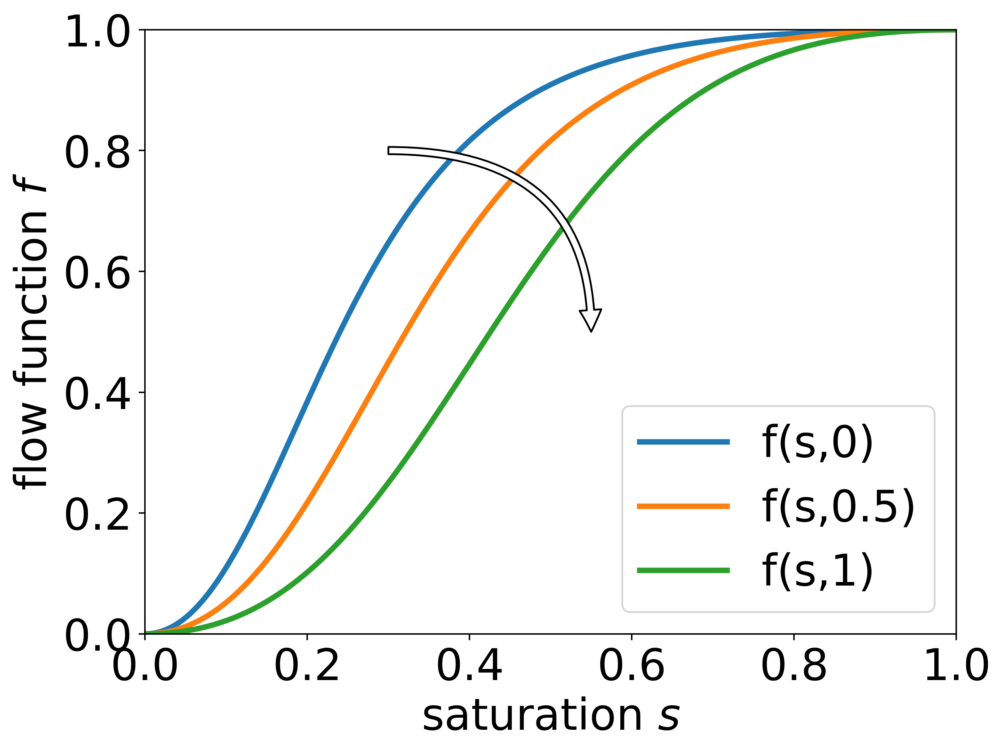
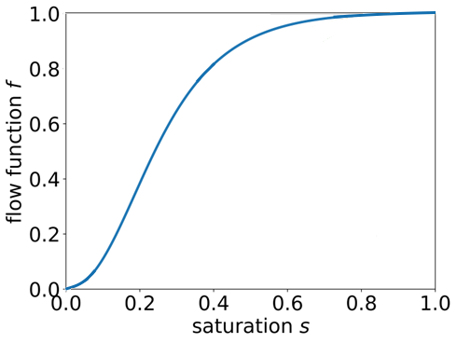
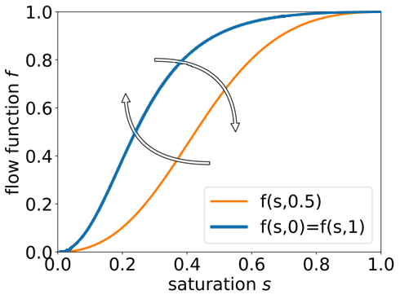
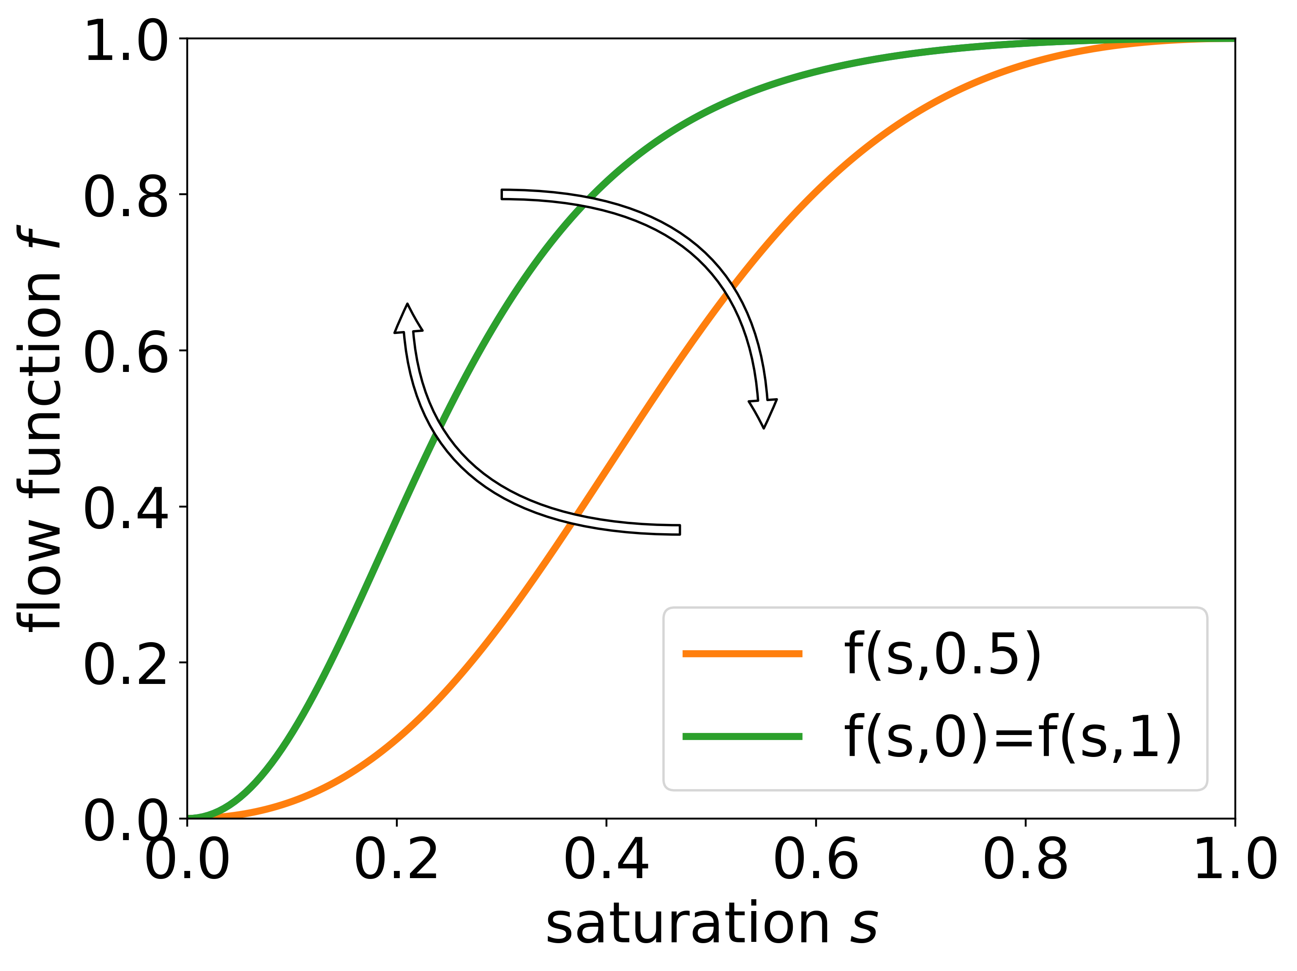
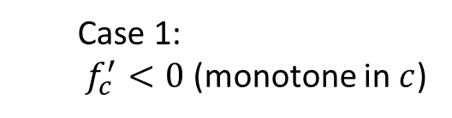
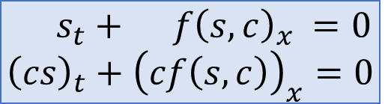
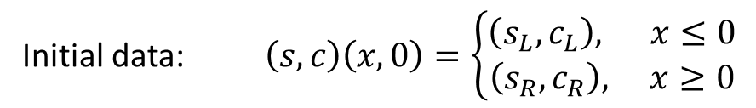
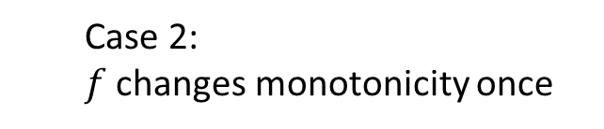
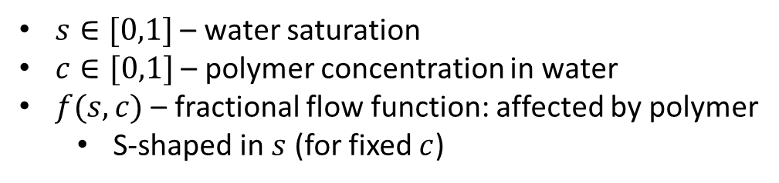
Glimm-Isaacson model (KKIT)
*
Two-phase oil-water flow with polymer in the water (1980)
Case 1:
$$s_{t}+ f{\left(s,c\right)}_{x} =0 \\ {\left(cs\right)}_{t}+{\left(cf\left(s,c\right)\right)}_{x}=0$$
$s∈[0,1]$ – water saturation
$c∈[0,1]$ – polymer concentration in water
$f(s,c)$ – fractional flow function: affected by polymer
S-shaped in $s$ (for fixed $c$)
z
Case 2:
Case 1: $f_{c}^{′}<0$ (monotone in $c$)
Case 2:
$f$ changes monotonicity once
Initial data: $\left(s,c\right)\left(x,0\right)=\left\{\begin{aligned}\left(s_{L},c_{L}\right), x≤0 \\ \left(s_{R},c_{R}\right), x≥0\end{aligned}\right.$
Question: find an exact solution $s(x,t)$ and $c(x,t)$ to any Riemann problem
NB: $s\left(x,t\right)=s(x/t)$ – self-similar
*
KKIT = Keyfitz, Kranzer, Isaacson, Temple
3

Slide 5
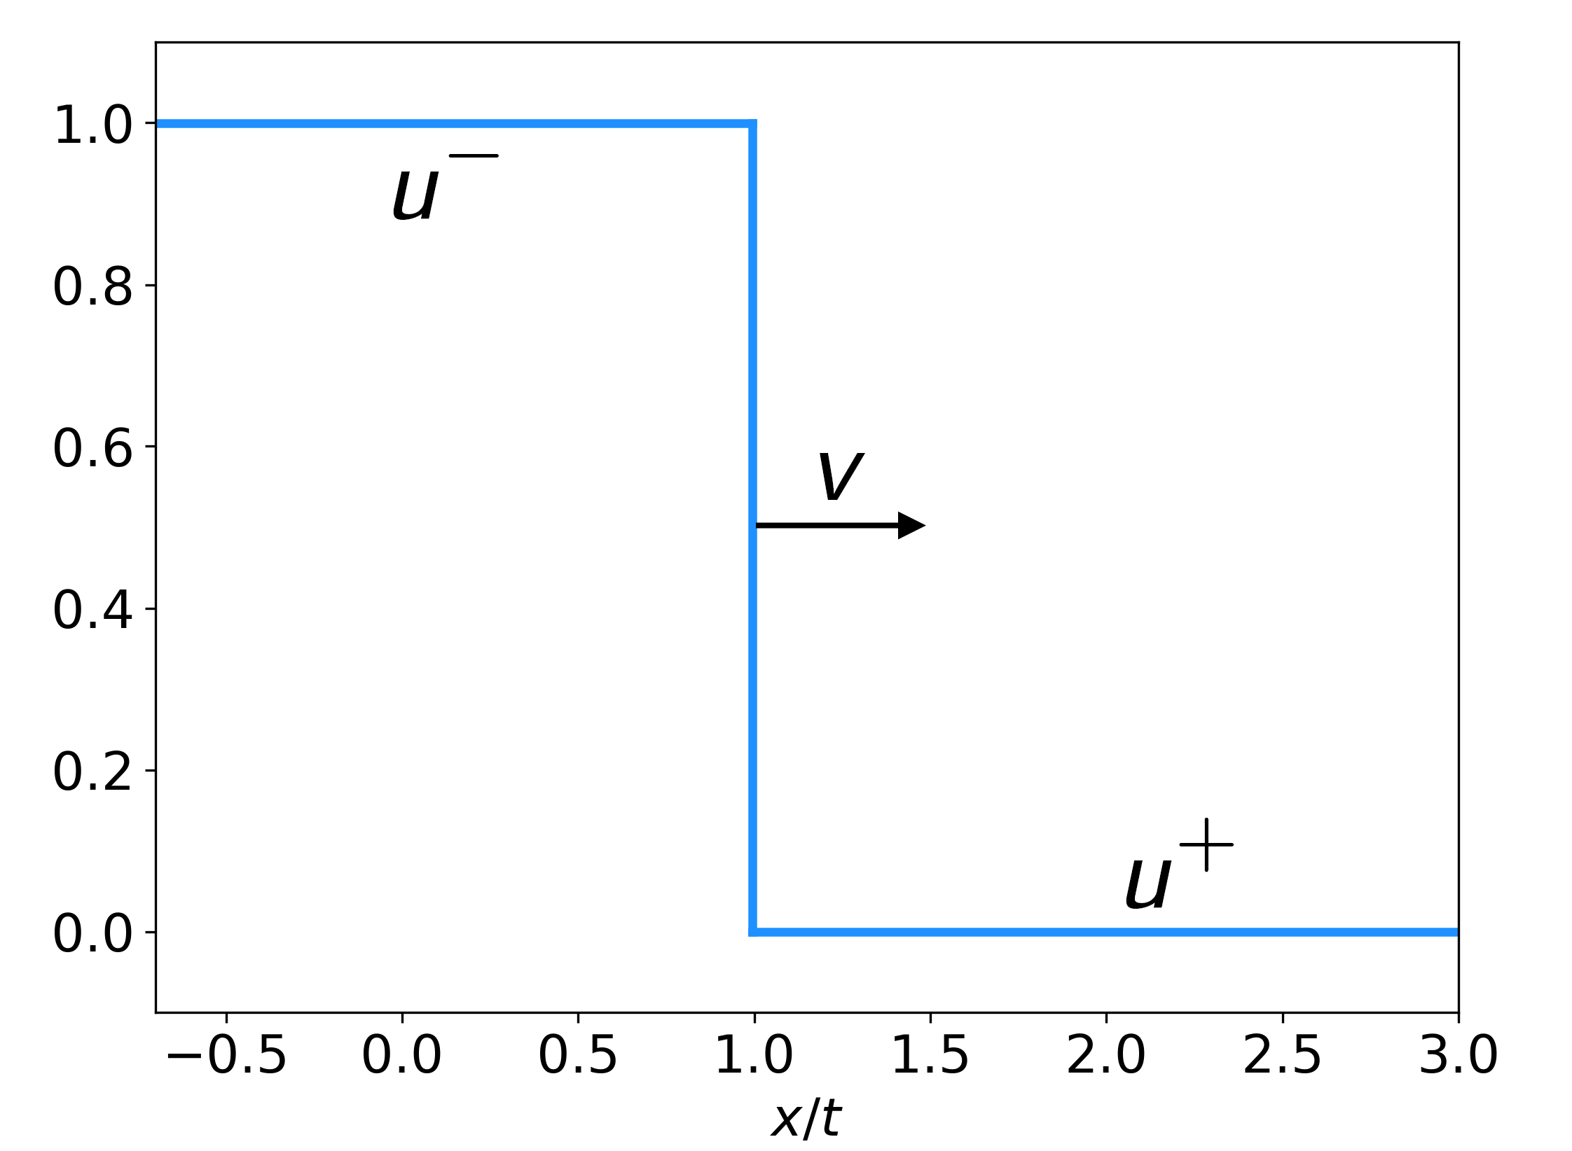
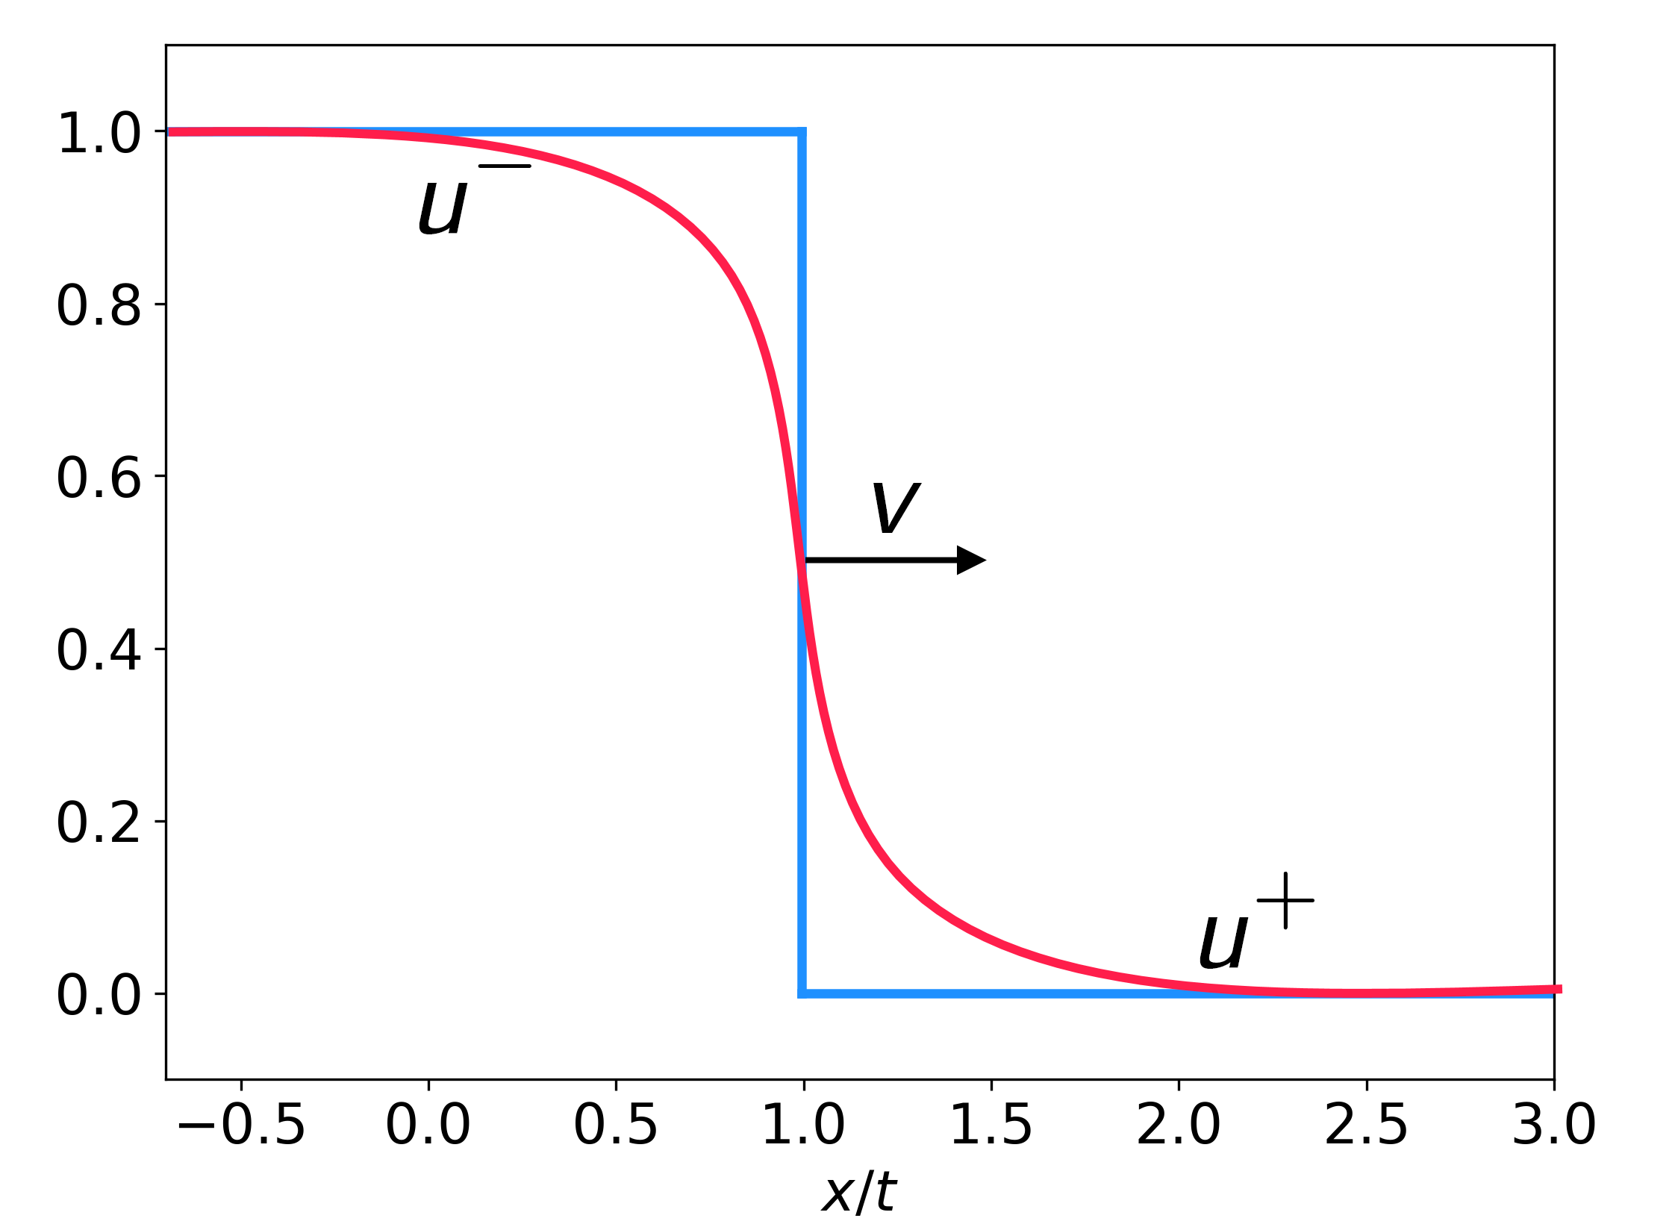
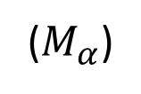
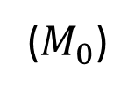
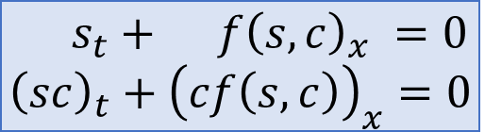
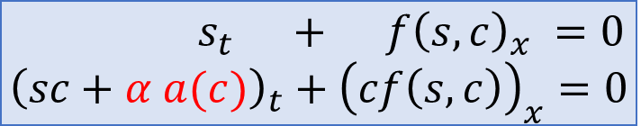
Main idea
Polymer model (1980’ E. Isaacson)
$$s_{t}+ f{\left(s,c\right)}_{x} =0 \\ {\left(sc\right)}_{t}+{\left(cf\left(s,c\right)\right)}_{x}=0$$
($M_{0}$)
Contact discontinuities (linearly degenerate) $⇒$ non-uniqueness of solutions
Vanishing viscosity criterion helps? Directly no…
Existing admissibility criteria need to be justified from “physical” perspective
Aim: select unique physically admissible weak solution
Main idea: add small physical effect – adsorption of polymer on the rock (1987 ’ T. Johansen, R. Winther)
$$s_{t} + f{\left(s,c\right)}_{x} =0 \\ {\left(sc+α a(c)\right)}_{t}+{\left(cf\left(s,c\right)\right)}_{x}=0$$
($M_{α}$)
Here $α>0$ - small, $a(c)$ – strictly concave
Contact discontinuities $⇝$ rarefaction and shock waves $⇝$ vanishing viscosity criteria is applicable
Vanishing adsorption criterion: the admissible contacts for $M_{0}$ are the $L_{loc}^{1}$ limits of a family of admissible
solutions for a Riemann problem for $M_{α}$ as $α→0$.
4

Slide 6
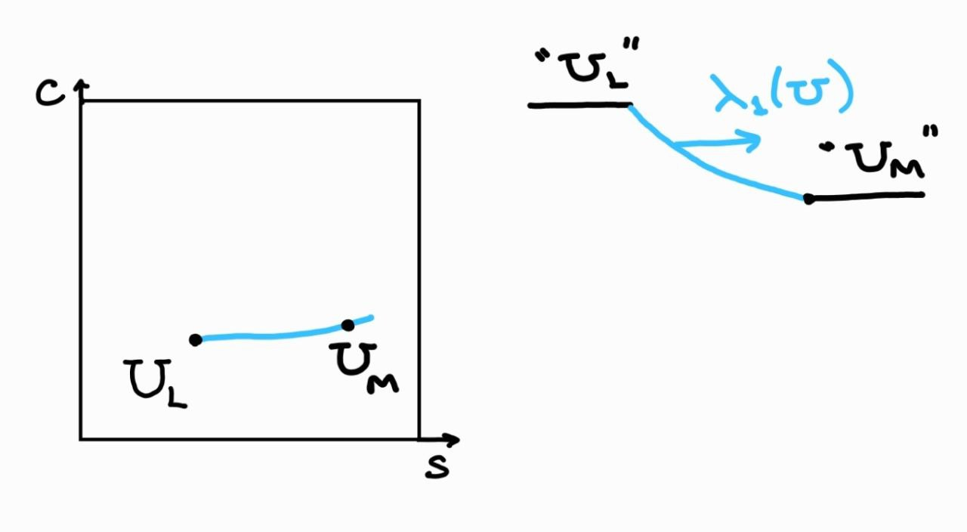
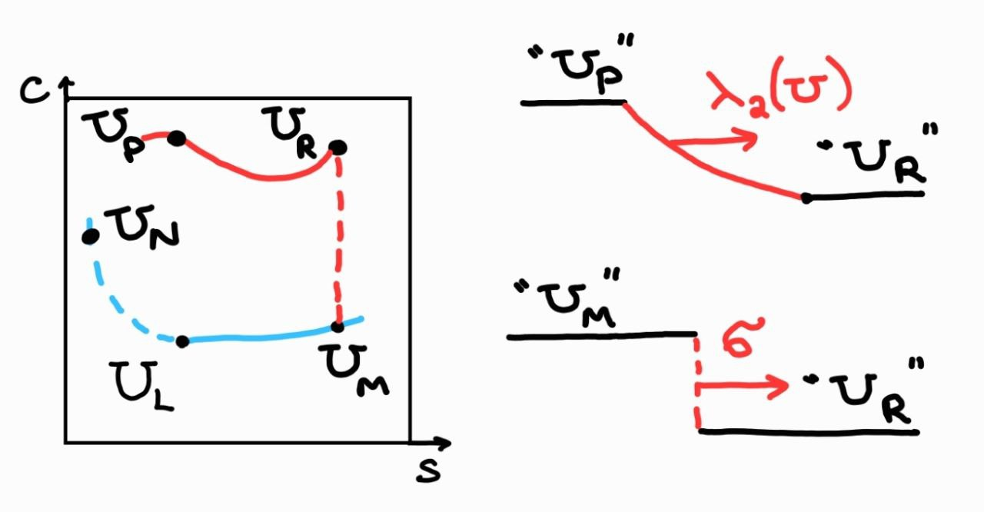
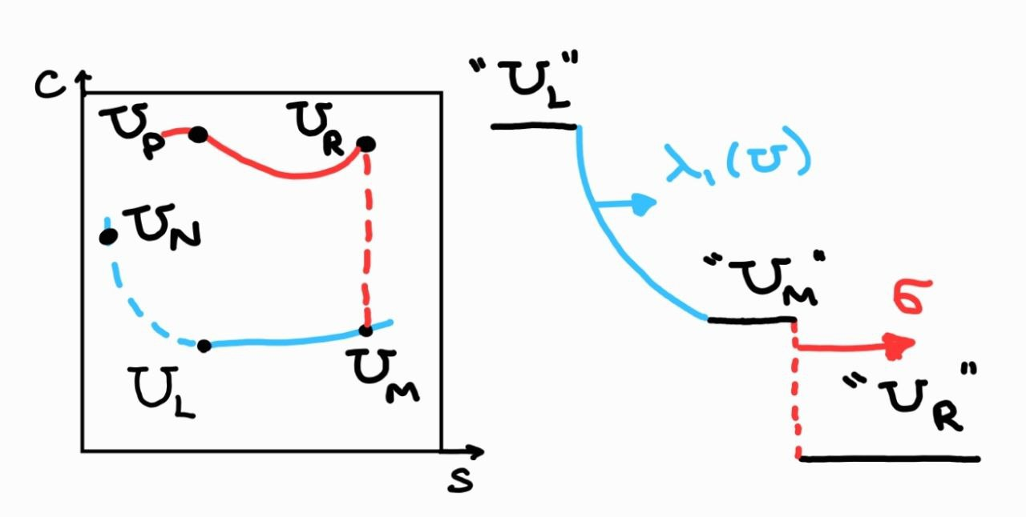
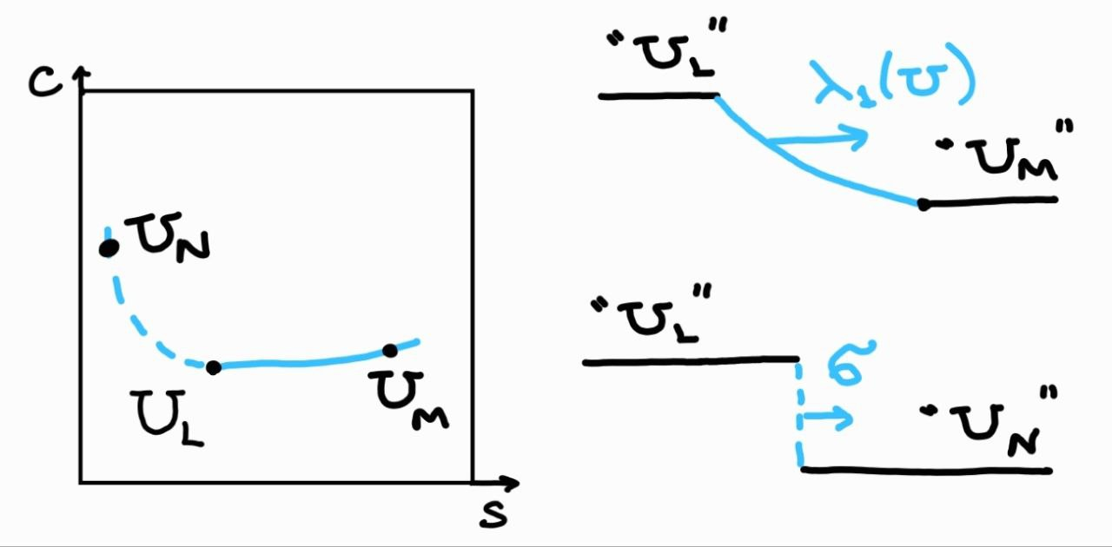
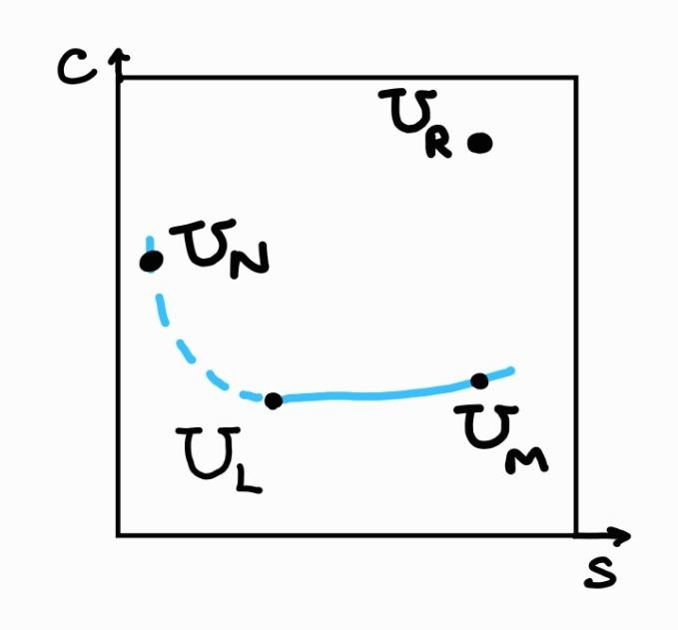
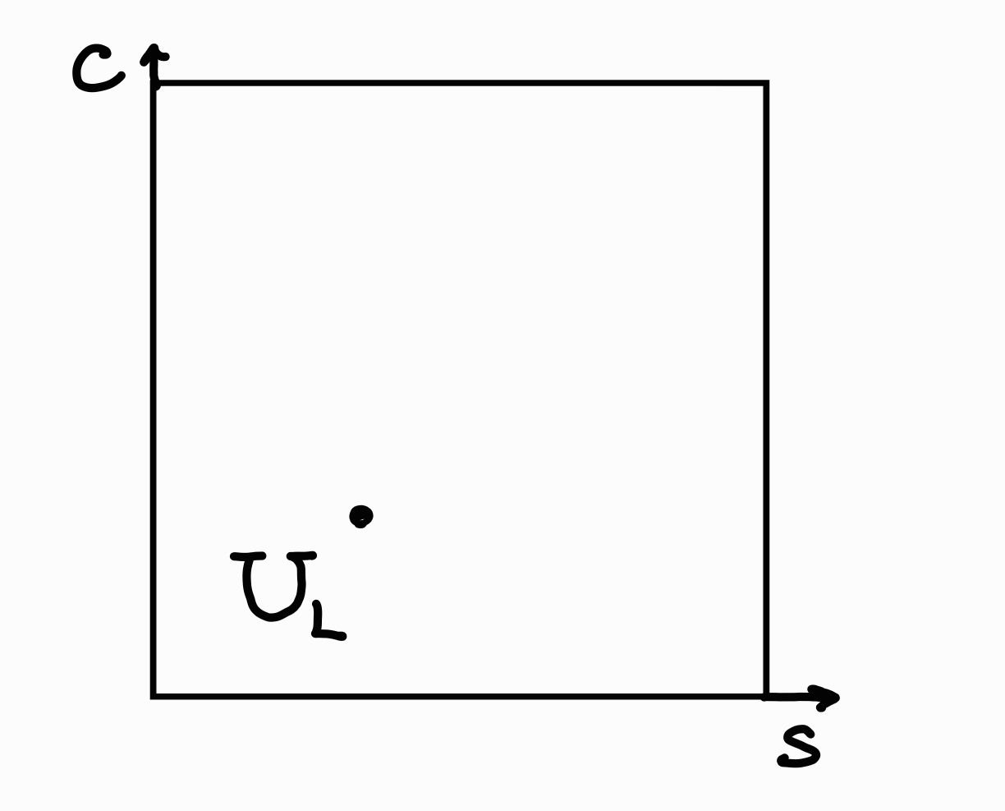
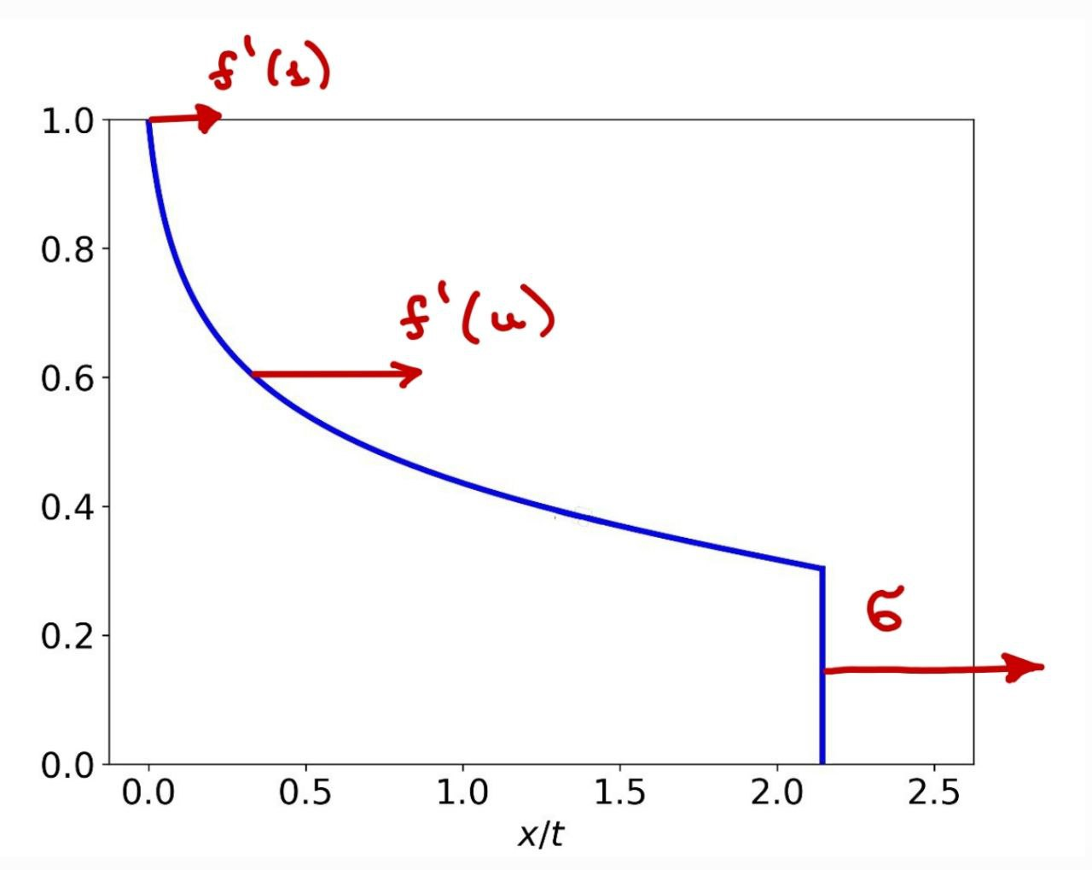
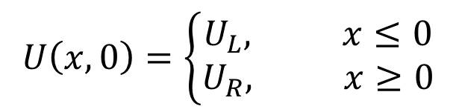
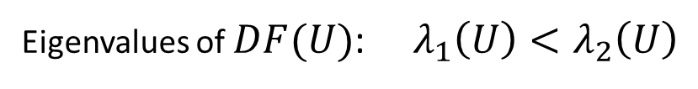
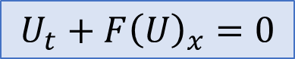
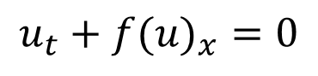
Algorithm to find a solution $U=(s,c)$ for $2×2$ systems
$$U_{t}+F{\left(U\right)}_{x}=0$$
Eigenvalues of $DF(U)$: $λ_{1}\left(U\right)<λ_{2}\left(U\right)$
Take $U_{L}$ and construct a “slow wave curve” corresponding to $λ_{1}(U)$
$$U\left(x,0\right)=\left\{\begin{aligned}U_{L}, x≤0 \\ U_{R}, x≥0\end{aligned}\right.$$
Take $U_{R}$ and construct a “fast wave curve” corresponding to $λ_{2}(U)$
Intersection of these two wave curves gives a solution
$$u_{t}+{f(u)}_{x}=0$$
5

Slide 7
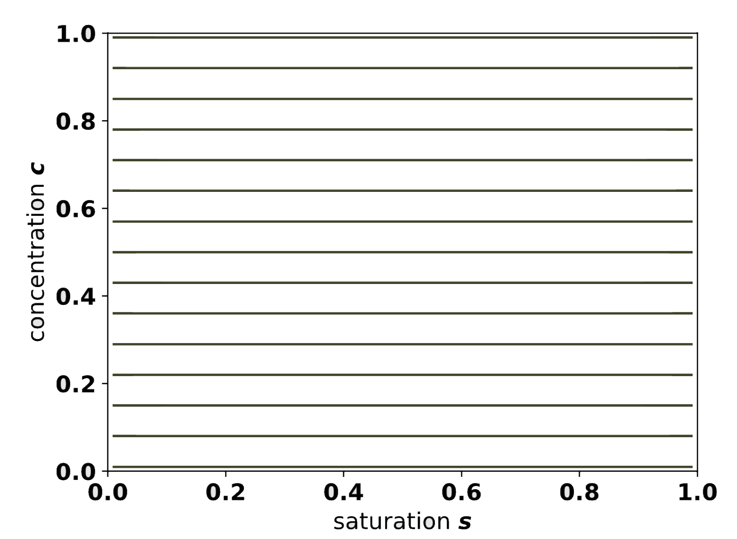
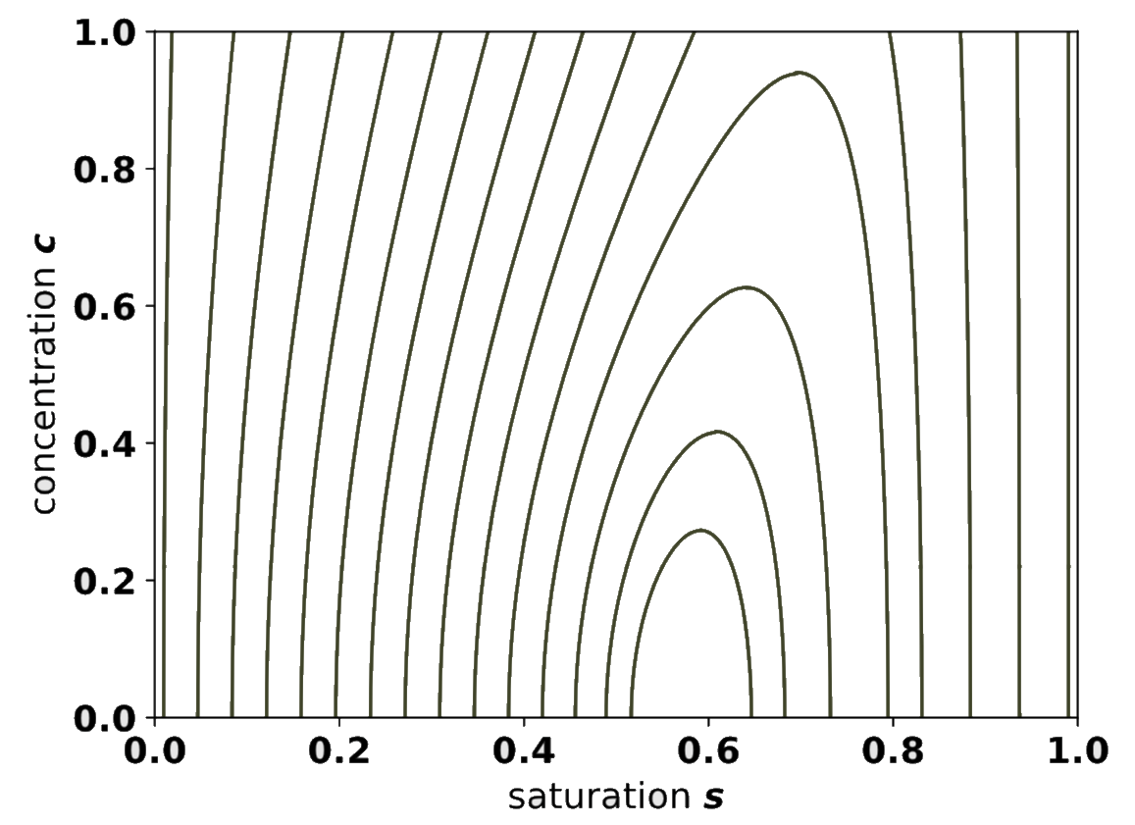
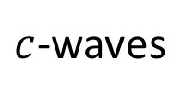
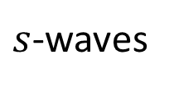
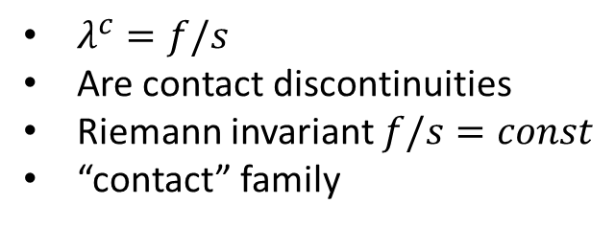
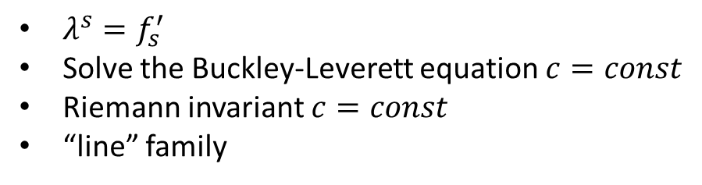
Characteristic families: s and c-waves
$s$-waves
$c$-waves
$λ^{s}=f_{s}^{′}$
Solve the Buckley-Leverett equation $c=const$
Riemann invariant $c=const$
“line” family
$λ^{c}=f/s$
Are contact discontinuities
Riemann invariant $f/s=const$
“contact” family
For both families, the rarefaction and shock curves coincide! But in a different way (Temple’1983)
Any solution for a Riemann problem is a combination of $s$ and $c$ waves
6

Slide 8
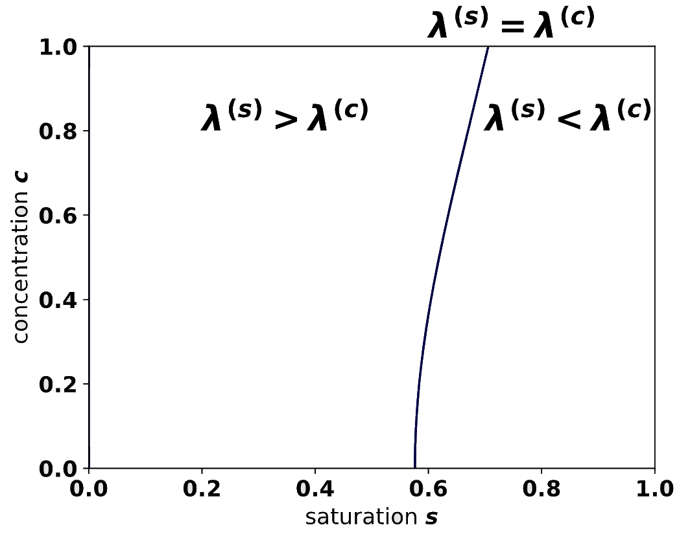
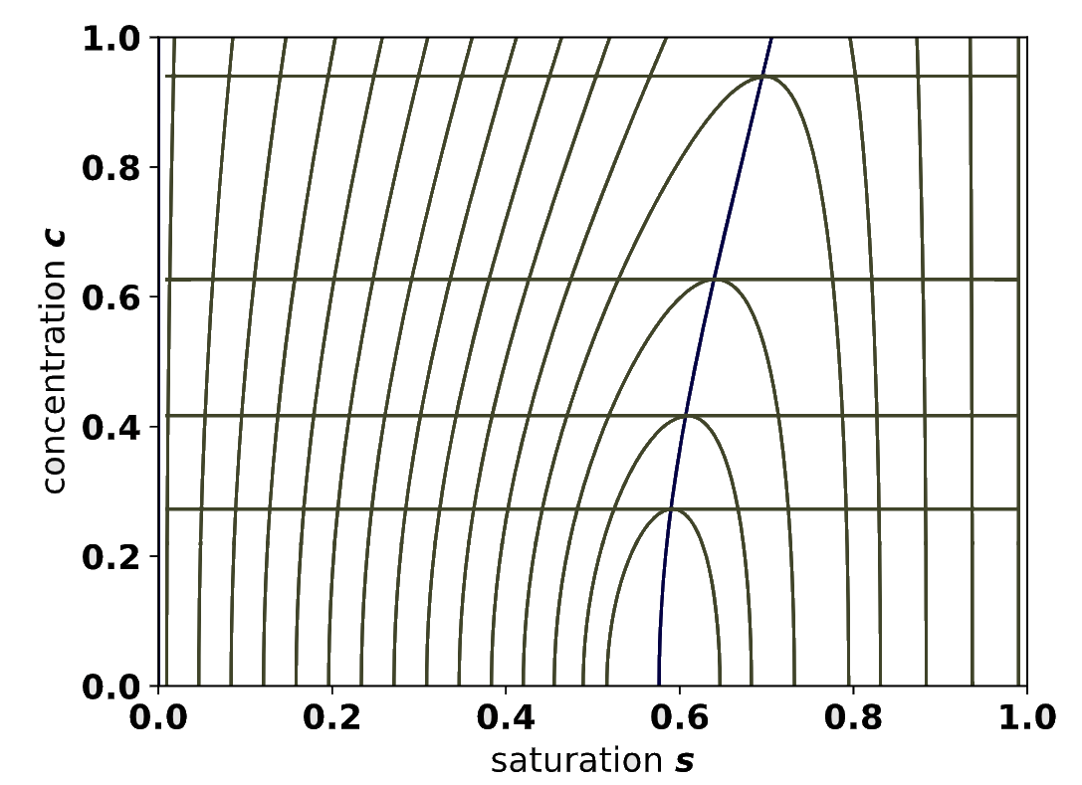
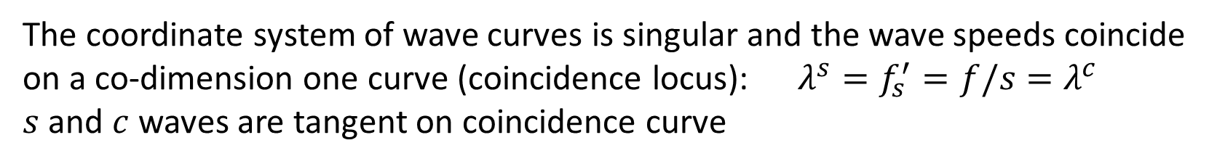
Non-strictly hyperbolic system
The coordinate system of wave curves is singular and the wave speeds coincide on a co-dimension one curve (coincidence locus): $λ^{s}=f_{s}^{′}=f/s=λ^{c}$
$s$and $c$ waves are tangent on coincidence curve
7

Slide 9
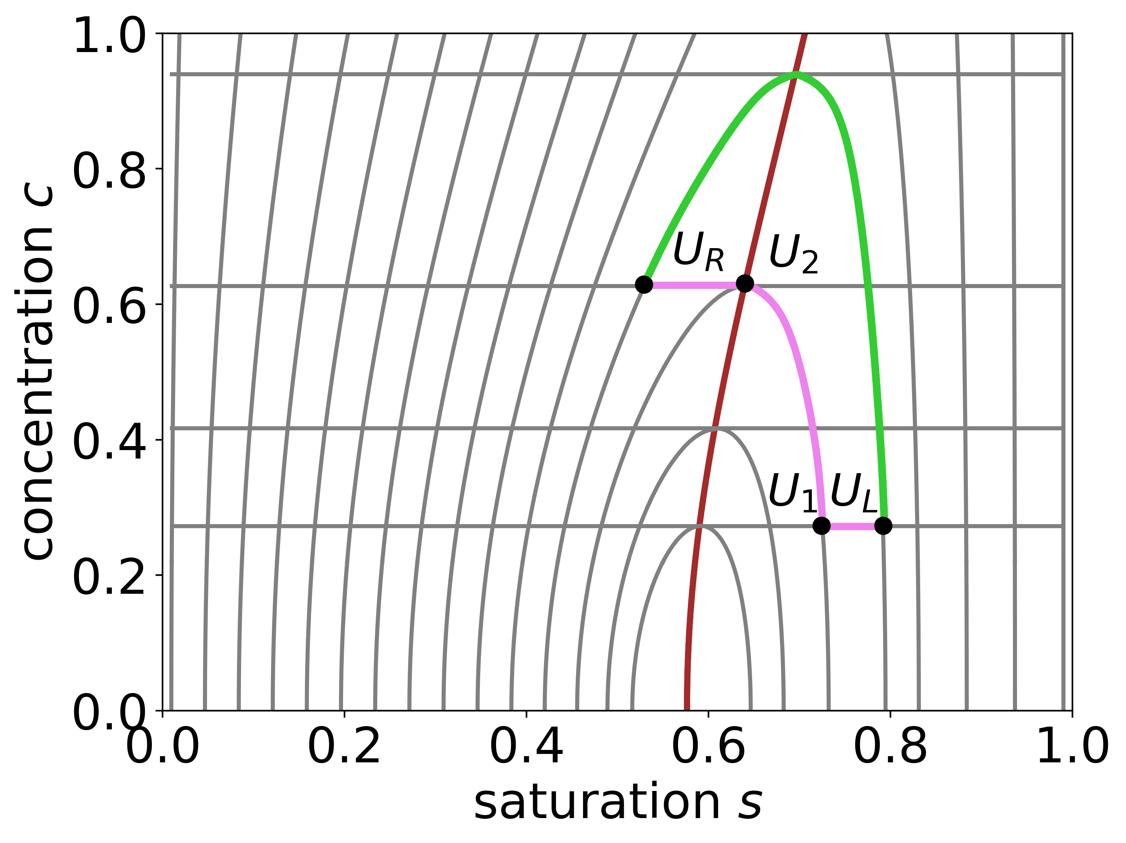
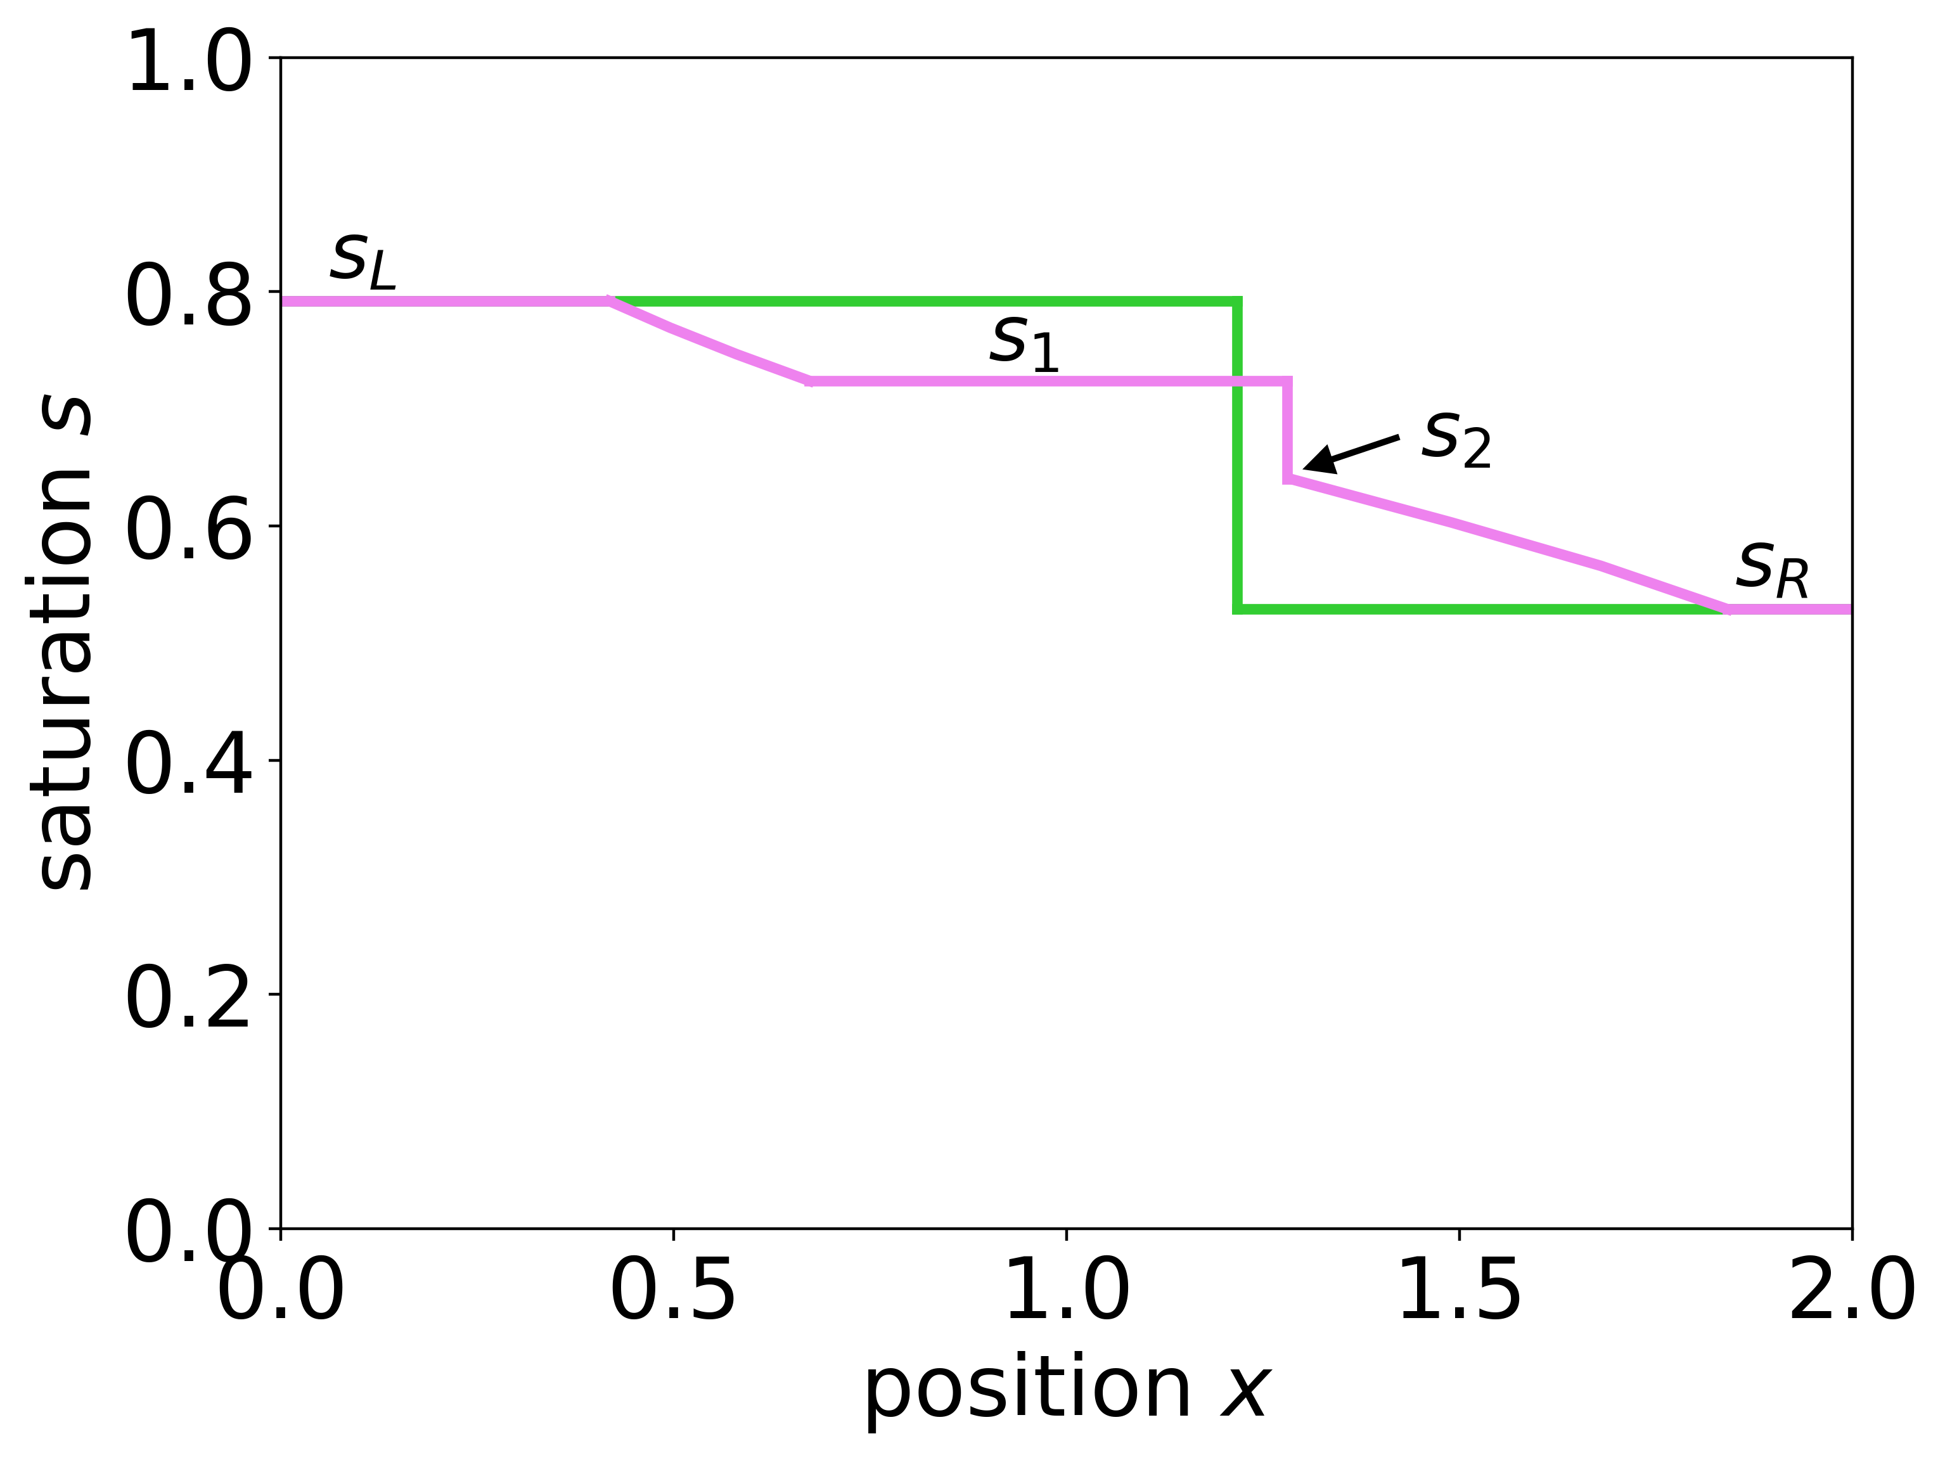
Non-uniqueness of solutions
A contact discontinuity between $U_{−}$ and $U_{+}$ is admissible if and only if:
Criterion 1 (Isaacson): either $U_{−}, U_{+}∈\{λ^{s}≥λ^{c}\}$ or $U_{−}, U_{+}∈\{λ^{s}≤λ^{c}\}$
Criterion 2 (de Souza-Marchesin): $c$ is continuous and monotone along the sequence of contact curves, connecting $U_{−}$ and $U_{+}$
What is the (physical) motivation of these criteria?
8

Slide 10
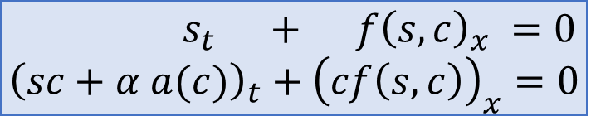
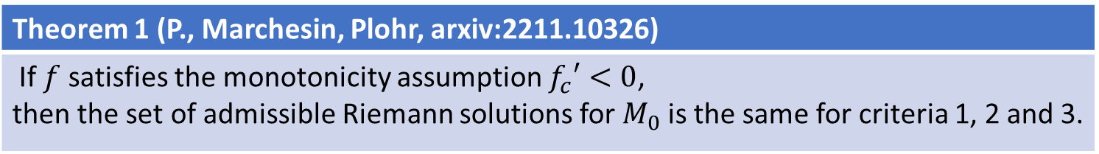
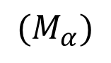
Main result
Polymer model
$$s_{t} + f{\left(s,c\right)}_{x} =0 \\ {\left(sc+α a(c)\right)}_{t}+{\left(cf\left(s,c\right)\right)}_{x}=0$$
$${(M}_{α})$$
Criterion 3: vanishing adsorption (Petrova-Marchesin-Plohr): A contact discontinuity between $U_{−}$ and $U_{+}$ for $M_{0}$ is admissible if and only if it is the $L_{loc}^{1}$ limit of a family of admissible solutions for a Riemann problem for $M_{α}$ as $α→0$.
Theorem 1 (P., Marchesin, Plohr, arxiv:2211.10326)
If $f$ satisfies the monotonicity assumption $f_{c}′<0$, then the set of admissible Riemann solutions for $M_{0}$ is the same for criteria 1, 2 and 3.
Case 1:
Corollary: any solution to a Riemann problem for $M_{0}$ exists and is unique.
Question: what happens when $f$ is non-monotone in $c$?
9

Slide 11
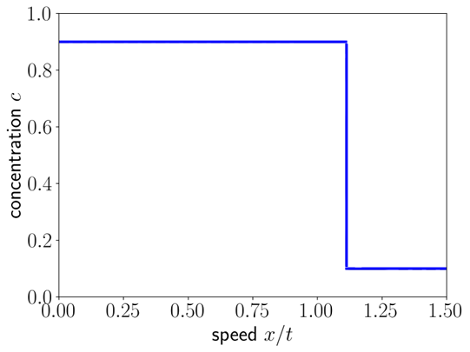
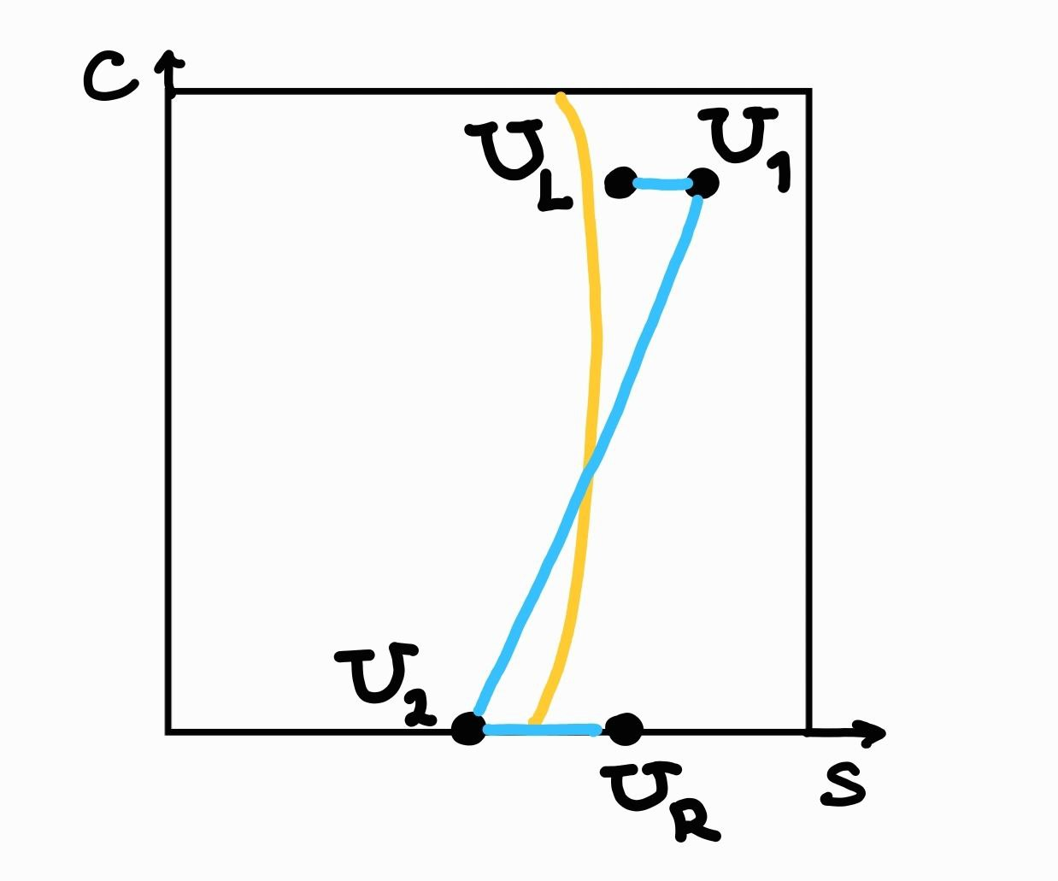
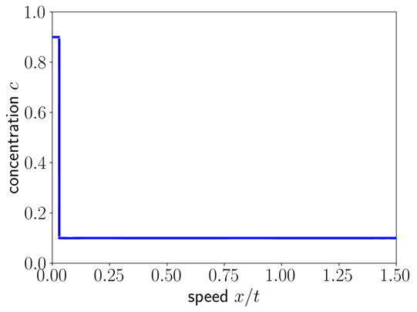
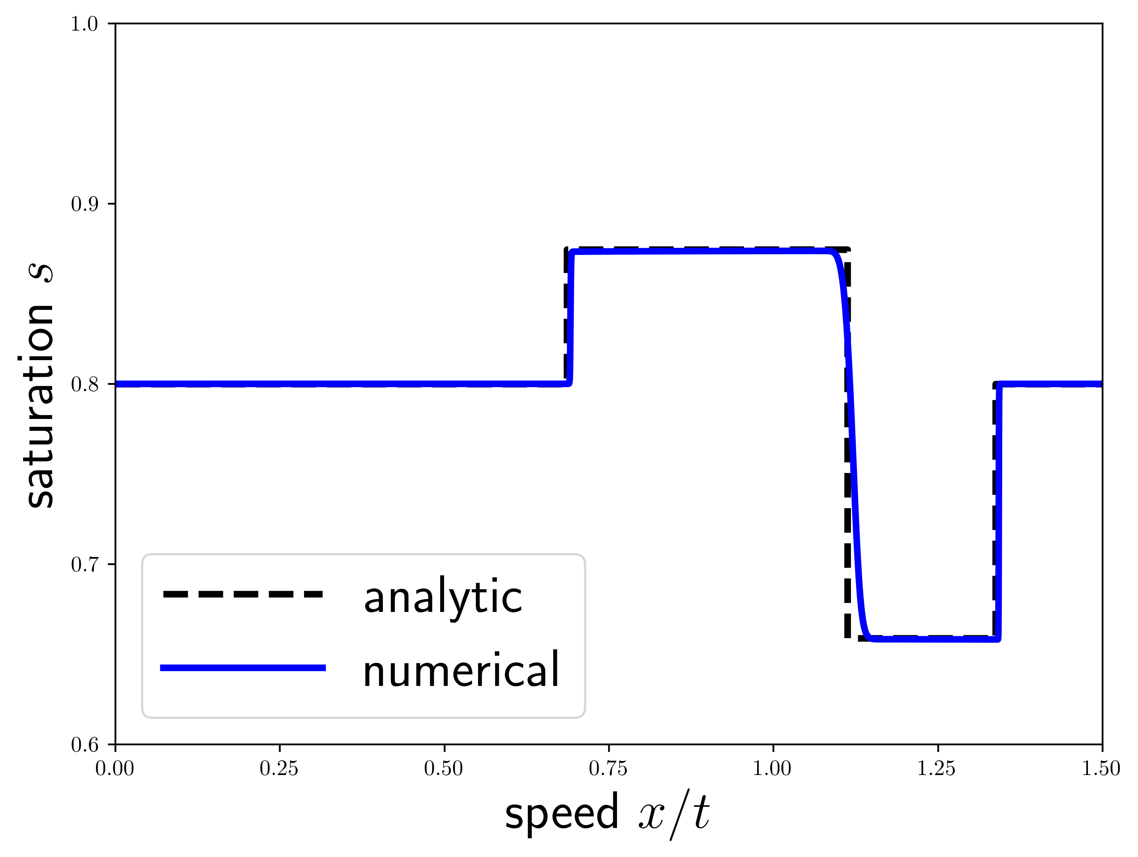
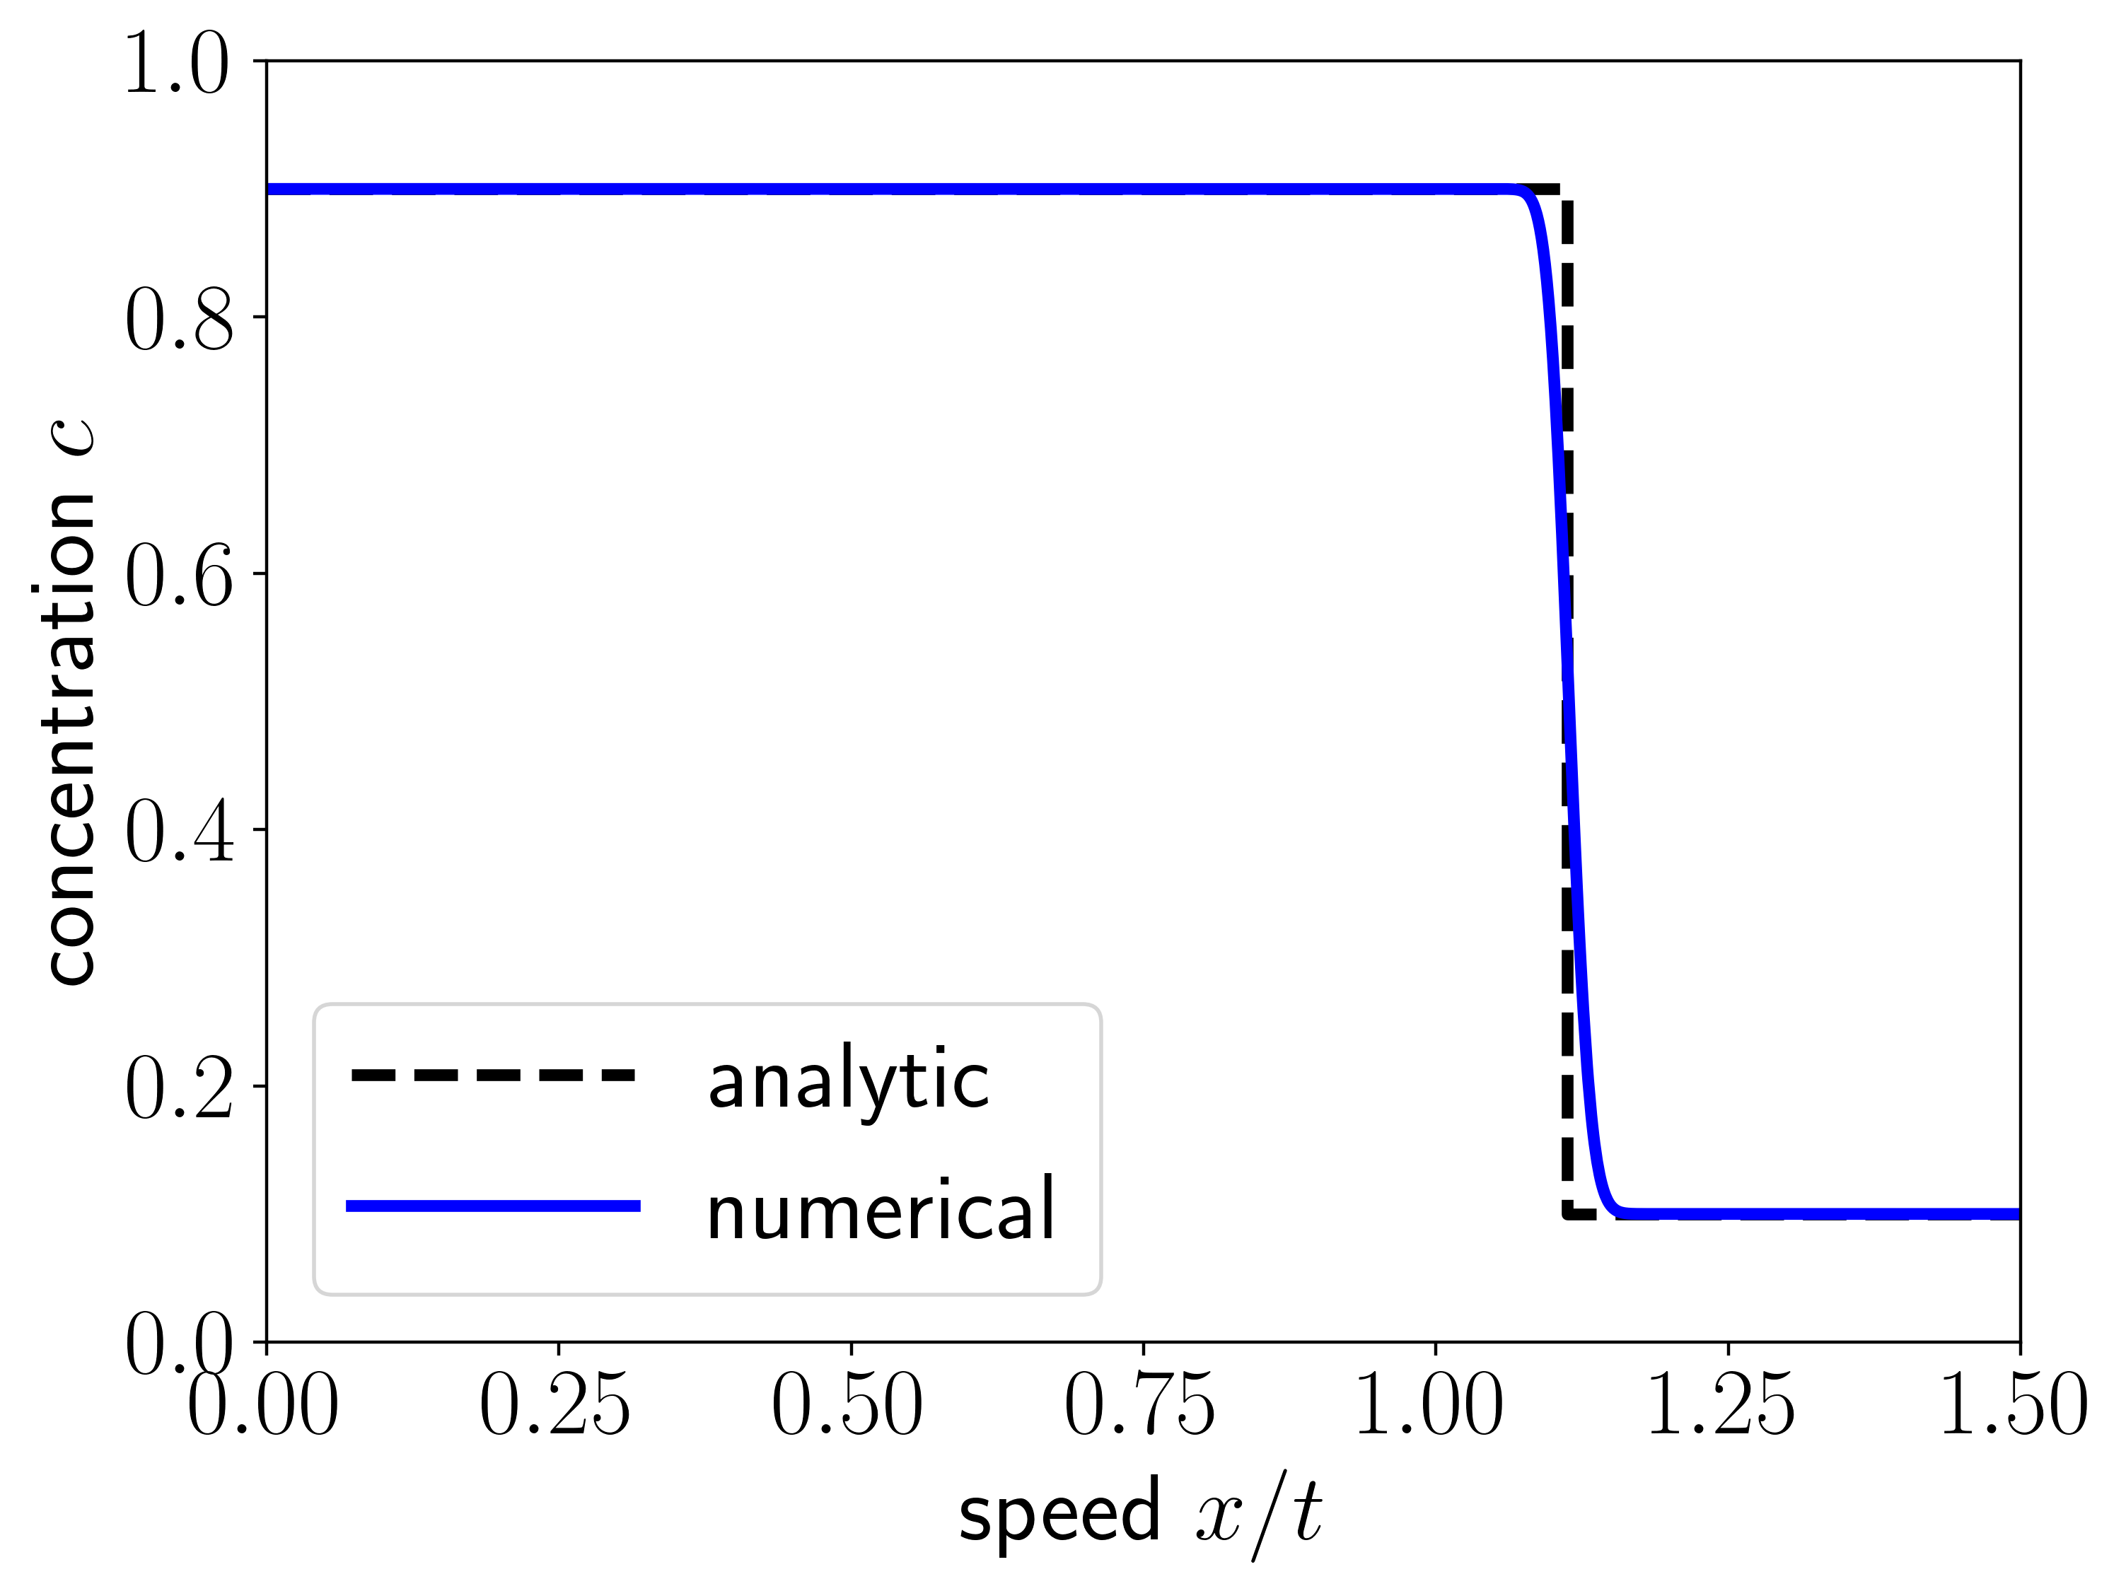



What happens when $f$ is non-monotone in $c$?
$$s_{t}+ f{\left(s,c\right)}_{x} =0 \\ {\left(sc\right)}_{t}+{\left(cf\left(s,c\right)\right)}_{x}=0$$
Example: “boomerang”
$f\left(s,c\right)=\frac{s^{2}}{s^{2}+μ\left(c\right){\left(1−s\right)}^{2}}$ with $μ\left(c\right)=1+4c(1−c)$
$$\left(s,c\right)(x,0)=\left\{\begin{aligned}\left(0.8, 1\right), x≤0 \\ \left(0.8, 0\right), x≥0\end{aligned}\right.$$
Riemann problem:
Results of numerical modelling:
10

Slide 12

…a more careful look…
$$s_{t}+ f{\left(s,c\right)}_{x} =0 \\ {\left(sc\right)}_{t}+{\left(cf\left(s,c\right)\right)}_{x}=0$$
Let’s call the corresponding contact discontinuity undercompressive
(it does NOT satisfy the Lax admissibility criterion)
Is this contact discontinuity admissible by the existing criteria?
Criteria 1: NO
Criteria 2: YES
Criteria 3: YES
Theorem 2 (P., Marchesin, Plohr, 2022, arxiv:2211.10326)
The undercompressive contact discontinuities satisfy the vanishing adsorption admissibility criterion
11

Slide 13





Main step in proof of Thm 2
$$s_{t} + f{\left(s,c\right)}_{x} =0 \\ {\left(sc+α a(c)\right)}_{t}+{\left(cf\left(s,c\right)\right)}_{x}=0$$
Add diffusion terms
$$s_{t} + f{\left(s,c\right)}_{x} =ε_{1}s_{xx} \\ {\left(sc+α a(c)\right)}_{t}+{\left(cf\left(s,c\right)\right)}_{x}=ε_{1}{\left(cs_{x}\right)}_{x}+ε_{2}c_{xx}$$
$$ε_{1}, ε_{2}→0, k=\frac{ε_{1}}{ε_{2}}$$
Travelling wave ansatz
$$s=s\left(x−σt\right)=s\left(ξ\right), c=c\left(x−σt\right)=c(ξ)$$
$$\left\{\begin{aligned}α⋅s_{ξ}=f−σ\left(s+d_{1}\right) \\ c_{ξ}=\frac{ε_{1}}{ε_{2}}⋅σ⋅(d_{1}c−d_{2}−a(c))\end{aligned}\right.$$
Theorem 3 (Bakharev, Enin, P., Rastegaev, 2023, JHDE)
For any $k=\frac{ε_{1}}{ε_{2}}>0$ there exists $s_{−}\left(k\right)$ and $s_{+}(k)$ and velocity $σ\left(k\right)$ such that there exists a travelling wave, connecting two saddle points $(s_{−}\left(k\right),1)$ and $(s_{+}\left(k\right),0)$ with velocity $σ(k)$.
12

Slide 14
References
Muito obrigada pela sua atenção!
Own works:
F. Bakharev, A. Enin, Y. Petrova, and N. Rastegaev. Impact of dissipation ratio on vanishing viscosity solutions of the Riemann problem for chemical flooding model. Journal of Hyperbolic Differential Equations, 20:1–26, 2023.
Y. Petrova, B. Plohr, and Marchesin D. Vanishing adsorption admissibility criterion for contact discontinuities in the polymer model. arXiv:2211.10326.
Y. Petrova, S. Tikhomirov, Ya. Efendiev. Propagating terrace in a two-tubes model of gravitational fingering, arXiv:2401.05981.
Other references: Polymer model:
W. Shen. On the Cauchy problems for polymer flooding with gravitation. Journal of Differential Equations, 261(1):627–653, 2016.
W. Shen. On the uniqueness of vanishing viscosity solutions for Riemann problems for polymer flooding. Nonlinear Differential Equations and Applications NoDEA, 24(4):37, 2017.
B. Temple. Global solution of the Cauchy problem for a class of 2×2 nonstrictly hyperbolic conservation laws. Advances in Applied Mathematics, 3(3):335–375, 1982.
T. Johansen and R. Winther. The solution of the Riemann problem for a hyperbolic system of conservation laws modeling polymer flooding. SIAM Journal on Mathematical Analysis, 19(3):541–566, 1988.
Keyfitz, B.L. and Kranzer, H.C., 1980. A system of non-strictly hyperbolic conservation laws arising in elasticity theory. Archive for Rational Mechanics and Analysis, 72(3), pp.219-241.
E. L. Isaacson, Global solution of a Riemann problem for a non-strictly hyperbolic system of conservation laws arising in enhanced oil recovery, Rockefeller University, New York, NY, preprint (1981).
13

